Slide 1


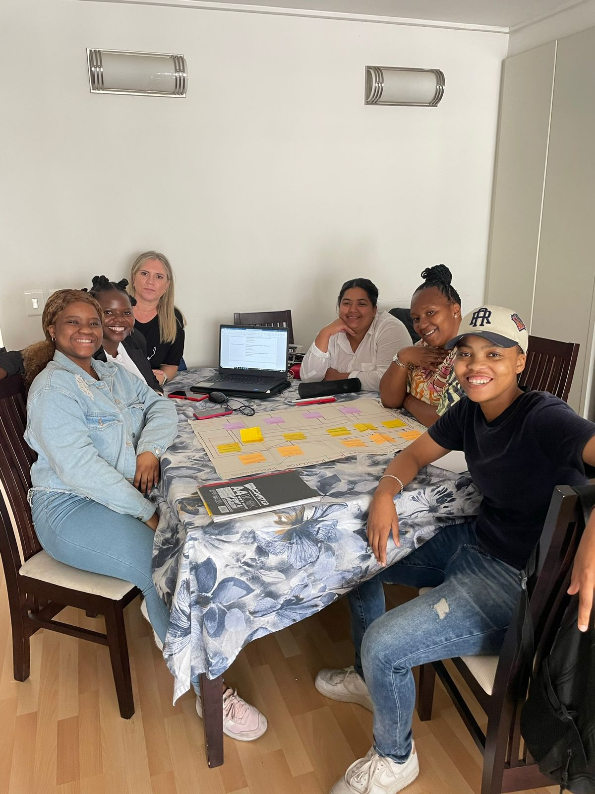
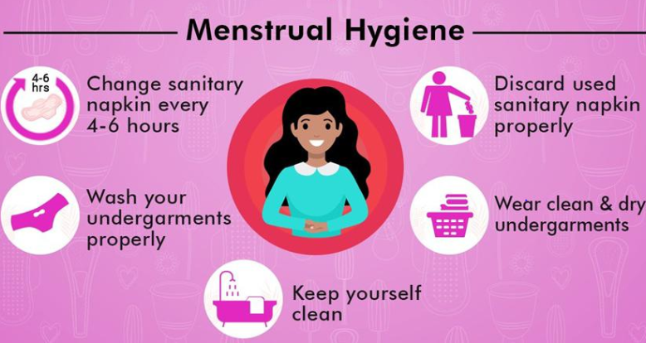
PROJECT PORTRAIT
Exploring the lived menstruation experiences of adult women
#659 (2023)
What is this project about?
The research
This study was conducted by a master’s of Public Health (MPH) student in collaboration with the NPO, Mpower Cup. The organisation wanted to understand how women from disadvantaged communities manage their menstruation. The aim of the research study explored the menstrual hygiene management (MHM) experiences of adult women from an under-resourced community in Cape Town. Key objectives of the study were:
To understand women’s lived experiences of MHM.
To explore their perceptions of the impacts of menstruation on their physical and psychological health and wellbeing.
To explore key informants’ perceptions of adult women’s experiences of MHM.
Qualitative in-depth interviews were conducted using a semi-structured interview guide with 10 women aged 25 to 49 and three key informants, namely, a maternal health nurse and two community health care workers. All participants were Xhosa-speaking from different areas in Khayelitsha. Access to the community was facilitated by the NPO, Mpower Cup.
Figure 2: Student disseminating findings of project to the Mpower Cup team
Figure 1: Summary of Menstrual Hygiene Management (MHM)
Findings
This qualitative exploratory research reveals that women's lived experiences of MHM (Menstrual Hygiene Management) are deeply influenced by the context in which they manage menstruation. The findings also highlight the adverse experiences associated with menstrual practices, including access to menstruation materials/products, water, health facilities for pain management, and individual attitudes toward menstruation. The study uncovers that adult women grapple with challenging menstrual experiences characterised by significant stress and anxiety stemming from menstrual stigma. Consequently, poor menstrual hygiene management adversely affects their physical and psychological well-being. The results emphasise the importance of menstrual management as a public health and human rights issue.

